Slide 1
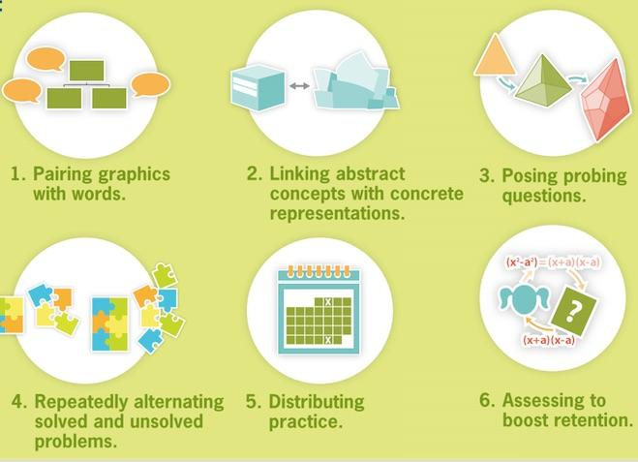
Make It Stick (by Roediger III, McDaniel, Brown)

Slide 2
Change response mode. | Provide outline of lesson/unit of study. | Place students close to teacher. | Encourage use of assignment books.
Have students turn lined paper vertically for math. | Use cues to denote important items. | Design hierarchical workshops: easiest to more difficult. | Allow use of instructional aids: number strips, calculators.
Display works samples: sets expectations clearly. | Use peer-mediated learning. | Use flexible work times. | Provide additional practice: have green folder ready for flow.
Block out extraneous stimuli. | Use of assistive technology: e-readers, text to speech, speech to text. | Develop reading guides. | Provide a glossary in content areas.
ADD
Notes:
ADD, output/performance strategies.

Slide 3
ASD
Calendars: visual timetables for day to day and long-term planning. | Teaching = clear & systematic: breaking down tasks into manageable chunks | Safe Space: an area where a student can have a break/calm down, decompress. | Find the reason for the behavior: usually linked with communication, sensory, social.
Clear targets for learning & production of work, projects, assignments. | Partner with parents: listen to their experiences, set goals together. ASD is 24/7. | Utilize skills & knowledge that student has already mastered to teach/learn new skills. | Share a common profile among teachers who are working with the student.
Use concrete thinking processes: flowcharts, thinking maps, checklists. | Harness special interests as motivation. | Range of strategies to help understand perspective, intentions of others. | Coaching/investing peers to provide support; specifically during transitions, collaborations.
10 - 15 minutes of individual time for check-in/coaching by an adult daily. | Weekly journal: allow for building relationship, emotional outlet. | Providing warning of any impending change of routine, or switch of activity. | Closed questioning: Give very clear choices: “Do you want to read or draw?”
Notes:
ASD strategy slide

Slide 4
Clarify/simplify written directions & repeat directions. | Maintain daily routines: structures support learning objectives. | Provide a copy of lesson notes. | Provide students with a graphic organizer, like thinking maps and model usage.
Clear targets for learning & production of work, projects, assignments. | Partner with parents: listen to their experiences, set goals together. | Emphasize daily review. | Share a common profile among teachers who are working with the student.
Use concrete thinking processes: flowcharts, thinking maps, checklists. | Use mnemonic instruction: memory devices to help remember key concepts. | Use balanced presentations & activities. | Coaching/investing peers to provide support; specifically during transitions, collaborations.
10 - 15 minutes of individual time for check-in/coaching by an adult daily. | Weekly journal: allow for building relationship, emotional outlet. | Providing warning of any impending change of routine, or switch of activity. | Closed questioning: Give very clear choices: “Do you want to read or draw?”
Dyslexia
Notes:
Dyslexia strategy slide

