Slide 1
Myers-Briggs Type Indicator (MBTI)
RESPECT SYMPOSIUM
Why Differences Matter? OR
What’s Your Type?
Mr. Ernewein
Director of Education
Denver Academy

Slide 2
CoffEE 1

Slide 3
Coffee 2

Slide 5
What do Coffee Beans have to do with MBTI?
Raising your awareness to information that is and was already there.
Once you are aware of it, its difficult to forget.
Increased knowledge of the types gives you a language & framework to talk about where we get our energy, how we make decisions and make sense of the world.

Slide 6
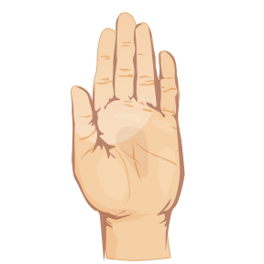
Activity # 1

Slide 7
Exercise
On a piece of paper, sign your name three times as you would normally.

Slide 8
Exercise
On a piece of paper, sign your name three times as you would normally.
Now sign your name three times with you non-preferred hand.

Slide 9
What words would you use to describe the process of signing your name with your preferred hand?

Slide 10
What words would you use to describe the process of signing your name with your preferred hand?
How about with you non-preferred hand?

Slide 11
The MBTI Connection
Your PREFERRED hand:
Feels natural, you didn’t think about it, it was effortless, looks neat and legible.
Your NONPREFERRED hand:
Feels unnatural, had to concentrate, was awkward, looks childlike.

Slide 12
Extraversion | How do you prefer to direct and get energy? | Introversion
Sensing | How do you prefer to take in information? | INtuition
Thinking | How do you prefer to make decisions? | Feeling
Judging | How do you prefer to live your life everyday? | Perceiving

Slide 13
There is no right or wrong to MBTI results
Each preference and type identifies valuable
human behaviors.

Slide 15
Exercise: a picture

Slide 17
Exercise
Jot down what you saw.

