Slide 1
What Diverse Learners Are Teaching Us
Starting with asking the right question, “How are you smart?” instead of “How smart are you?” – this session will highlight the insights learned from students about their struggles with learning and provide specific strategies teachers can use to enable students to reach their fullest potential. The session will include video clips of students sharing their own stories, as well as specific strategies to create a learning environment that honors diverse learners.
Philippe Ernewein, MA
Director of Education
Denver Academy

Slide 2
Objectives
Share 10 big ideas learned from diverse learners over 28 years.
Model & guide us through a memory palace.
Create actionable steps for Monday.
Directions For Hand-out
Create your own memory palace.
Take notes, doodles, lists
No paper airplanes please until after presentation

Slide 3
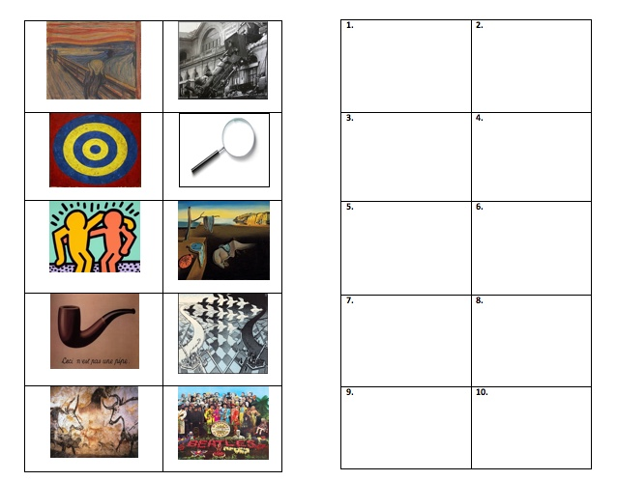
Philippe Ernewein, MA,
Director of Education, Denver Academy
www.rememberit.org: resources & contact information

Slide 4
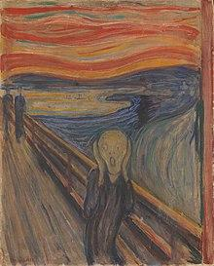
1. We cannot underestimate how stress impacts learning for many of our students.

Slide 5
Dr. Jerome Schultz, Clinical Neuropsychologist, Harvard Medical School
“We tend to see these behaviors as oppositional, but for many students they may actually be protective.”
“We are wired to survive.”
Schultz studies the impact of chronic stress exposure on children & teens with ADHD and learning disabilities.
Notes:
Many students with ADHD and other learning disabilities are working very hard, yet often continue to experience ongoing failure and frustration at school…
Some will behave in ways that divert attention from situations that can lead to further shame and public embarassment….

Slide 6
D | Define | Analyze & understand student’s unique learning profile
E | Educate | “How does ADHD/LD impact my school work and my life?”
S | Speculate | Anticipate challenges, identify strategies & supports
T | Teach | Knowledge brings power; learn ways to alleviate & manage stress
R | Reduce Threat | Create safe space; start to recognize triggers
E | Exercise | Regular physical activity is key
S | Success | Repeated opportunities to experience success
S | Strategies | Draw upon previous lessons; actively employ strategies solo
Notes:
Steps in the DE-STRESS model

Slide 7
2. Executive functioning is a process, not an event.

Slide 8
Sarah Ward, Director of Cognitive Connections
How far into the future can they anticipate?
2 years old: NOW
3-5 years old: 5-20 minutes
1st grade: Several hours
3rd grade: 8 - 12 hours
12-16 years old: 2-3 days
17-23 years old: 2-3 weeks
23-35 years old: 3 -5 week
Notes:
Speech & language pathologist, Concord, MA
Development of the time horizon; asking the question: How far into the future can they anticipate?

Slide 9
Understanding and Practicing Situational Intelligence: STOP
SPACE: read the room
What’s going on?
Expected/unexpected?
TIME: get on the timeline
What’s happening at this moment in time?
Pace/time of day?
OBJECTS: read the objects
Look for objects/parts
Location/purpose
PEOPLE: read the person
What are they telling you?
Look at face, body & appearance

Slide 10
3. We are all teachers of literacy.

Slide 11
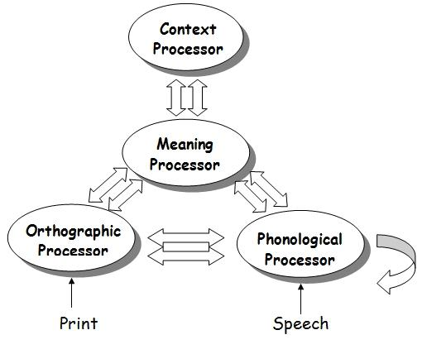
Louisa Moats, Ed. D. (2007). Courage To Risk Conference hand-out
Notes:
Understand this: How reading works
The brain performs four distinct processes when we read.
Orthographic Processor
This is the first step in reading – visual information causes the system to kick in. We see a string of symbols (letters).
Phonological Processor
The letters (symbols) are identified as a word; their spoken equivalent.
Meaning Processor
We reference our mental dictionary of words to find the meaning of the word.
Context Processor
We select word meanings appropriate for the text being read

Slide 12
“English Spelling is NOT Crazy”
Louisa Moats: author, researcher, teacher
Why is spelling instruction important?
Learning to spell is not natural
Better spelling enables better writing
Spelling instruction can improve phonological awareness, word recognition, and vocabulary
Notes:
Dr. Moats’ books include Speech to Print: Language Essentials for Teachers (Brookes Publishing); Spelling: Development, Disability, and Instruction (Pro-Ed); Straight Talk About Reading (with Susan Hall,Contemporary Books), and Basic Facts about Dyslexia.

Slide 13
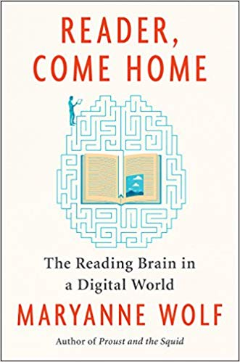
We need to be aware of the medium in which we present information and how we expect them to show what they know.

Slide 14
“I might want to suggest from me that our challenge in a digital world is not to choose between digital and print mediums, but rather to choose which cognitive, linguistic, and empathic processes we wish to preserve and expand in the next generation and in ourselves.”

Slide 15
4. Develop a watchful eye.

Slide 16
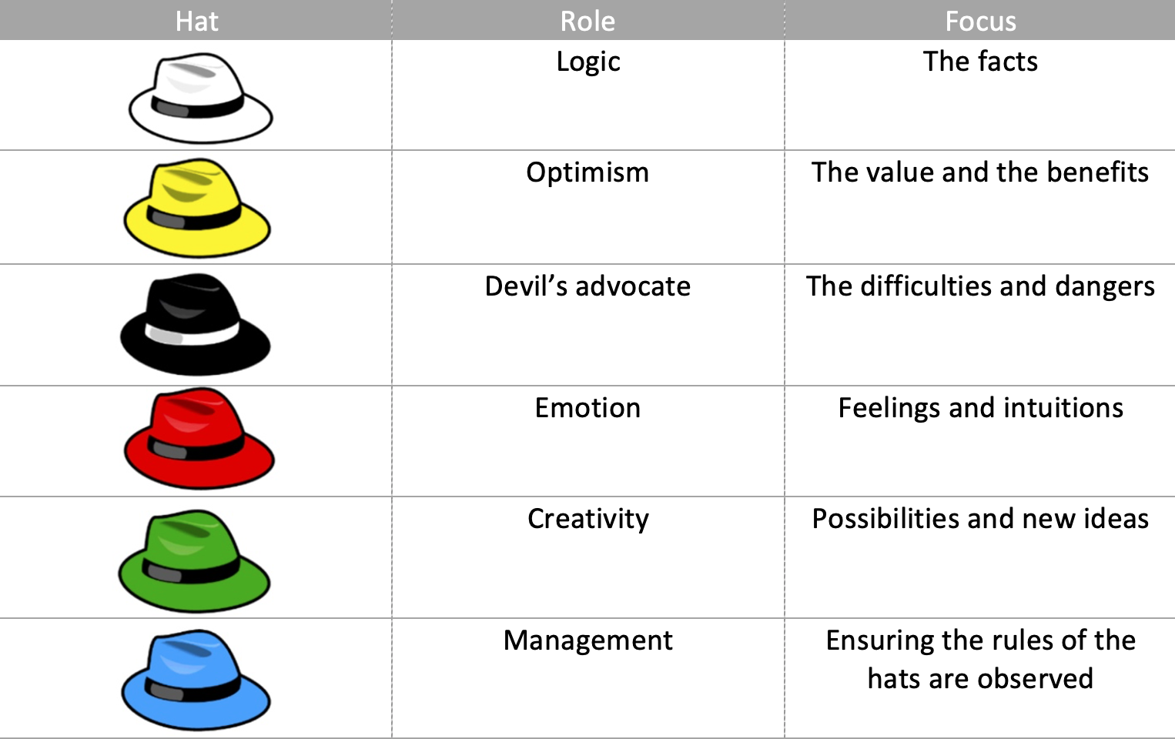
The Global Institute for Lifelong Empowerment (GiLE) is a foundation based in Budapest, Hungary.
Edward DeBono’s Thinking Hats: Defined

Slide 17
Dr. Brad Witzel, College of Education at Winthrop University
“A great number of people are gaining influence in education, not because their research is excellent, or even accurate, but because they sell a message of fantastical ease that learning is fluid and should always be fun.”
“I have heard teachers tell me that they love the work of {insert author} and ignore sound research because it clashes with said author.”
Notes:
Witzel, B. S. (2006). Manipulative instruction for elementary classrooms. Invited paper presented
at the Courage to Risk Conference. Colorado Springs, CO.
Witzel, B. S. (2004). Using multisensory algebra with struggling math students. Invited
presentation at The Math on the Planes Conference (sponsored by the Colorado Learning
Disabilities Association and Council of Learning Disabilities in cooperation with the
Colorado State Department of Education). Denver, CO.
Bradley S. Witzel, Ph.D., Professor
Program Director of the fully online MEd in Intervention
Department of Counseling, Leadership and Educational Studies
College of Education
Winthrop University

Slide 18
Dr. Brad Witzel, College of Education at Winthrop University
“We all must become better consumers of research. Differentiate self-fulfilling correlations from empirical research; research-based from research-supported; and opinions from evidence.”
Notes:
Witzel, B. S. (2006). Manipulative instruction for elementary classrooms. Invited paper presented
at the Courage to Risk Conference. Colorado Springs, CO.
Witzel, B. S. (2004). Using multisensory algebra with struggling math students. Invited
presentation at The Math on the Planes Conference (sponsored by the Colorado Learning
Disabilities Association and Council of Learning Disabilities in cooperation with the
Colorado State Department of Education). Denver, CO.
Bradley S. Witzel, Ph.D., Professor
Program Director of the fully online MEd in Intervention
Department of Counseling, Leadership and Educational Studies
College of Education
Winthrop University

Slide 19
Dr. Brad Witzel, College of Education at Winthrop University
“We all must become better consumers of research. Differentiate self-fulfilling correlations from empirical research; research-based from research-supported; and opinions from evidence.”
“Without our watchful eye, we are doomed to take steps back from the great strides that have been made.”
Notes:
Witzel, B. S. (2006). Manipulative instruction for elementary classrooms. Invited paper presented
at the Courage to Risk Conference. Colorado Springs, CO.
Witzel, B. S. (2004). Using multisensory algebra with struggling math students. Invited
presentation at The Math on the Planes Conference (sponsored by the Colorado Learning
Disabilities Association and Council of Learning Disabilities in cooperation with the
Colorado State Department of Education). Denver, CO.
Bradley S. Witzel, Ph.D., Professor
Program Director of the fully online MEd in Intervention
Department of Counseling, Leadership and Educational Studies
College of Education
Winthrop University

Slide 20
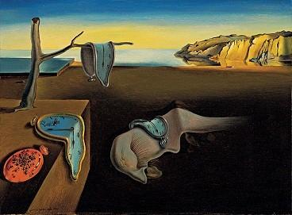
5. Commit to 20 minutes-a-day for your own PD.

Slide 21
6. Parents as allies.

Slide 22
6. Parents as allies.
Be specific when sharing information; both positives and concerns.
Bag the jargon, if you use it, explain it!
Outline mutual expectations.

Slide 23
7. Students as advocates.
Notes:
The famous pipe. How people reproached me for it! And yet, could you stuff my pipe? No, it's just a representation, is it not? So if I had written on my picture 'This is a pipe', I'd have been lying!
— René Magritte
Magritte's way of saying that, "an image is not be confused with something tangible"

Slide 24
7. Students as advocates.
“You got to know me, as a human and as a learner. Then you shared with me what you learned about me as a learner, and the strategies that seemed to work and not work - you gave me feedback. Then, when I had to advocate for myself, I just thought back on those two first steps - and I was able to self-advocate.”
Who am I as a learner?
Reflect on who I am as a learner.
Able to better self-advocate

Slide 25
OK, your turn: add these images and related concepts/ideas to your memory palace.
Notes:
Real quick

Slide 26
8. Understanding how learning works is far more important than what you learn.

Slide 27
“The Most Popular Online Course Teaches You to Learn”
The world’s most popular online course is a general introduction to the art of learning, taught jointly by an educator and a neuroscientist.
“Learning How To Learn,” which was created by Barbara Oakley, an electrical engineer, has been ranked as the leading class by enrollment as the largest online course.
The course is “aimed at a broad audience of learners who wanted to improve their learning performance based on what we know about how brains learn.”
Over 2,000,000 registered students
Notes:
New York Times headline, December 2015
In 5 years, over 2 million students have enrolled “Learning How to Learn,” which is offered by the University of California through Coursera, an online learning company which has partnered with a number of universities.
Completion rate is above 20 percent,roughly twice the average for most MOOCs (massive open online courses)

Slide 28
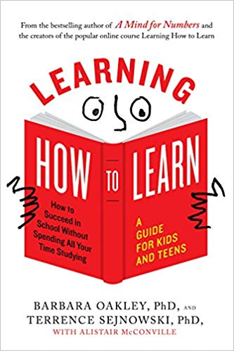

Slide 29
8. Understanding how learning works is far more important than what you learn.
“Focused” and “Diffused” Modes
Retrieval Practice
Pomodoro Technique
Notes:
When learning, there are times in which you are focused and times in which you allow your mind to wander. This unfocused, or diffused, mode is just as valuable as the focused mode in allowing your brain to LEARN something. So — take breaks, meditate, think about other things, and give yourself plenty of time in both modes.
One way of making sure you’re taking regular breaks is to follow the Pomodoro technique. This is where you program for 25 minutes, then take a break for 5 minutes. The work and break time lengths can vary based on what works best for you. The important part is that you have a regular break. There are several applications out there that help you setup a Pomodoro timer.
Dr. Oakley points to Dr. Jeff Karpicke’s research about retrieval practice to provide scientific support behind taking a couple minutes to summarize or recall material you are trying to learn. It goes a long way to taking something from short-term memory to long-term learning. Even recalling material in different physical environments can help you grasp the material independent of any physical cues that your brain may have.

Slide 31
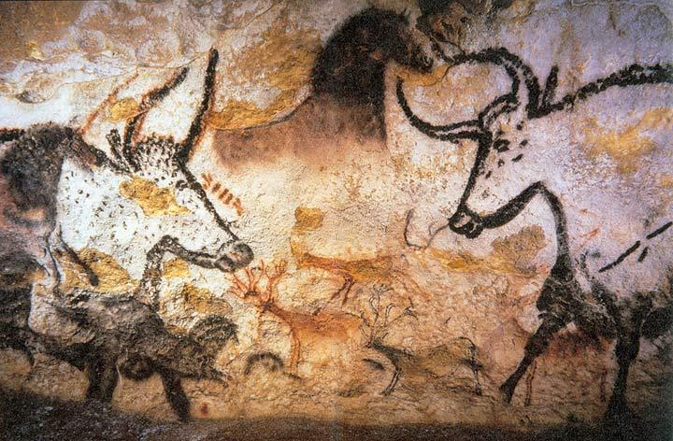
9. Find something good.

Slide 32
Asset-Based Thinking
Remedy for:
“You see what’s bad before you see what’s good - negative bias invites us to see & respond more intensely to problems rather than possibilities.”
Ask yourself:
What’s working and which strengths are present?
Pioneered by psychologist Dr. Kathy Cramer
Notes:
Asset-Based thinking
Remedy for: you see what’s bad before you see what’s good - negative bias invites us to see & respond more intensely to problems rather than possibilities
Look at yourself and the world through the eyes of what’s working; ask, what’s working? What strengths are present?
This is not pie-in-the-sky; it’s a decision to ID & maximize what’s right, powerful & effective.
ABT is at the center of a worldwide movement, showing hundreds of thousands of people how to make small shifts in perception and thinking.

Slide 33
10. Find a mentor.
Notes:
Find a mentor

Slide 34
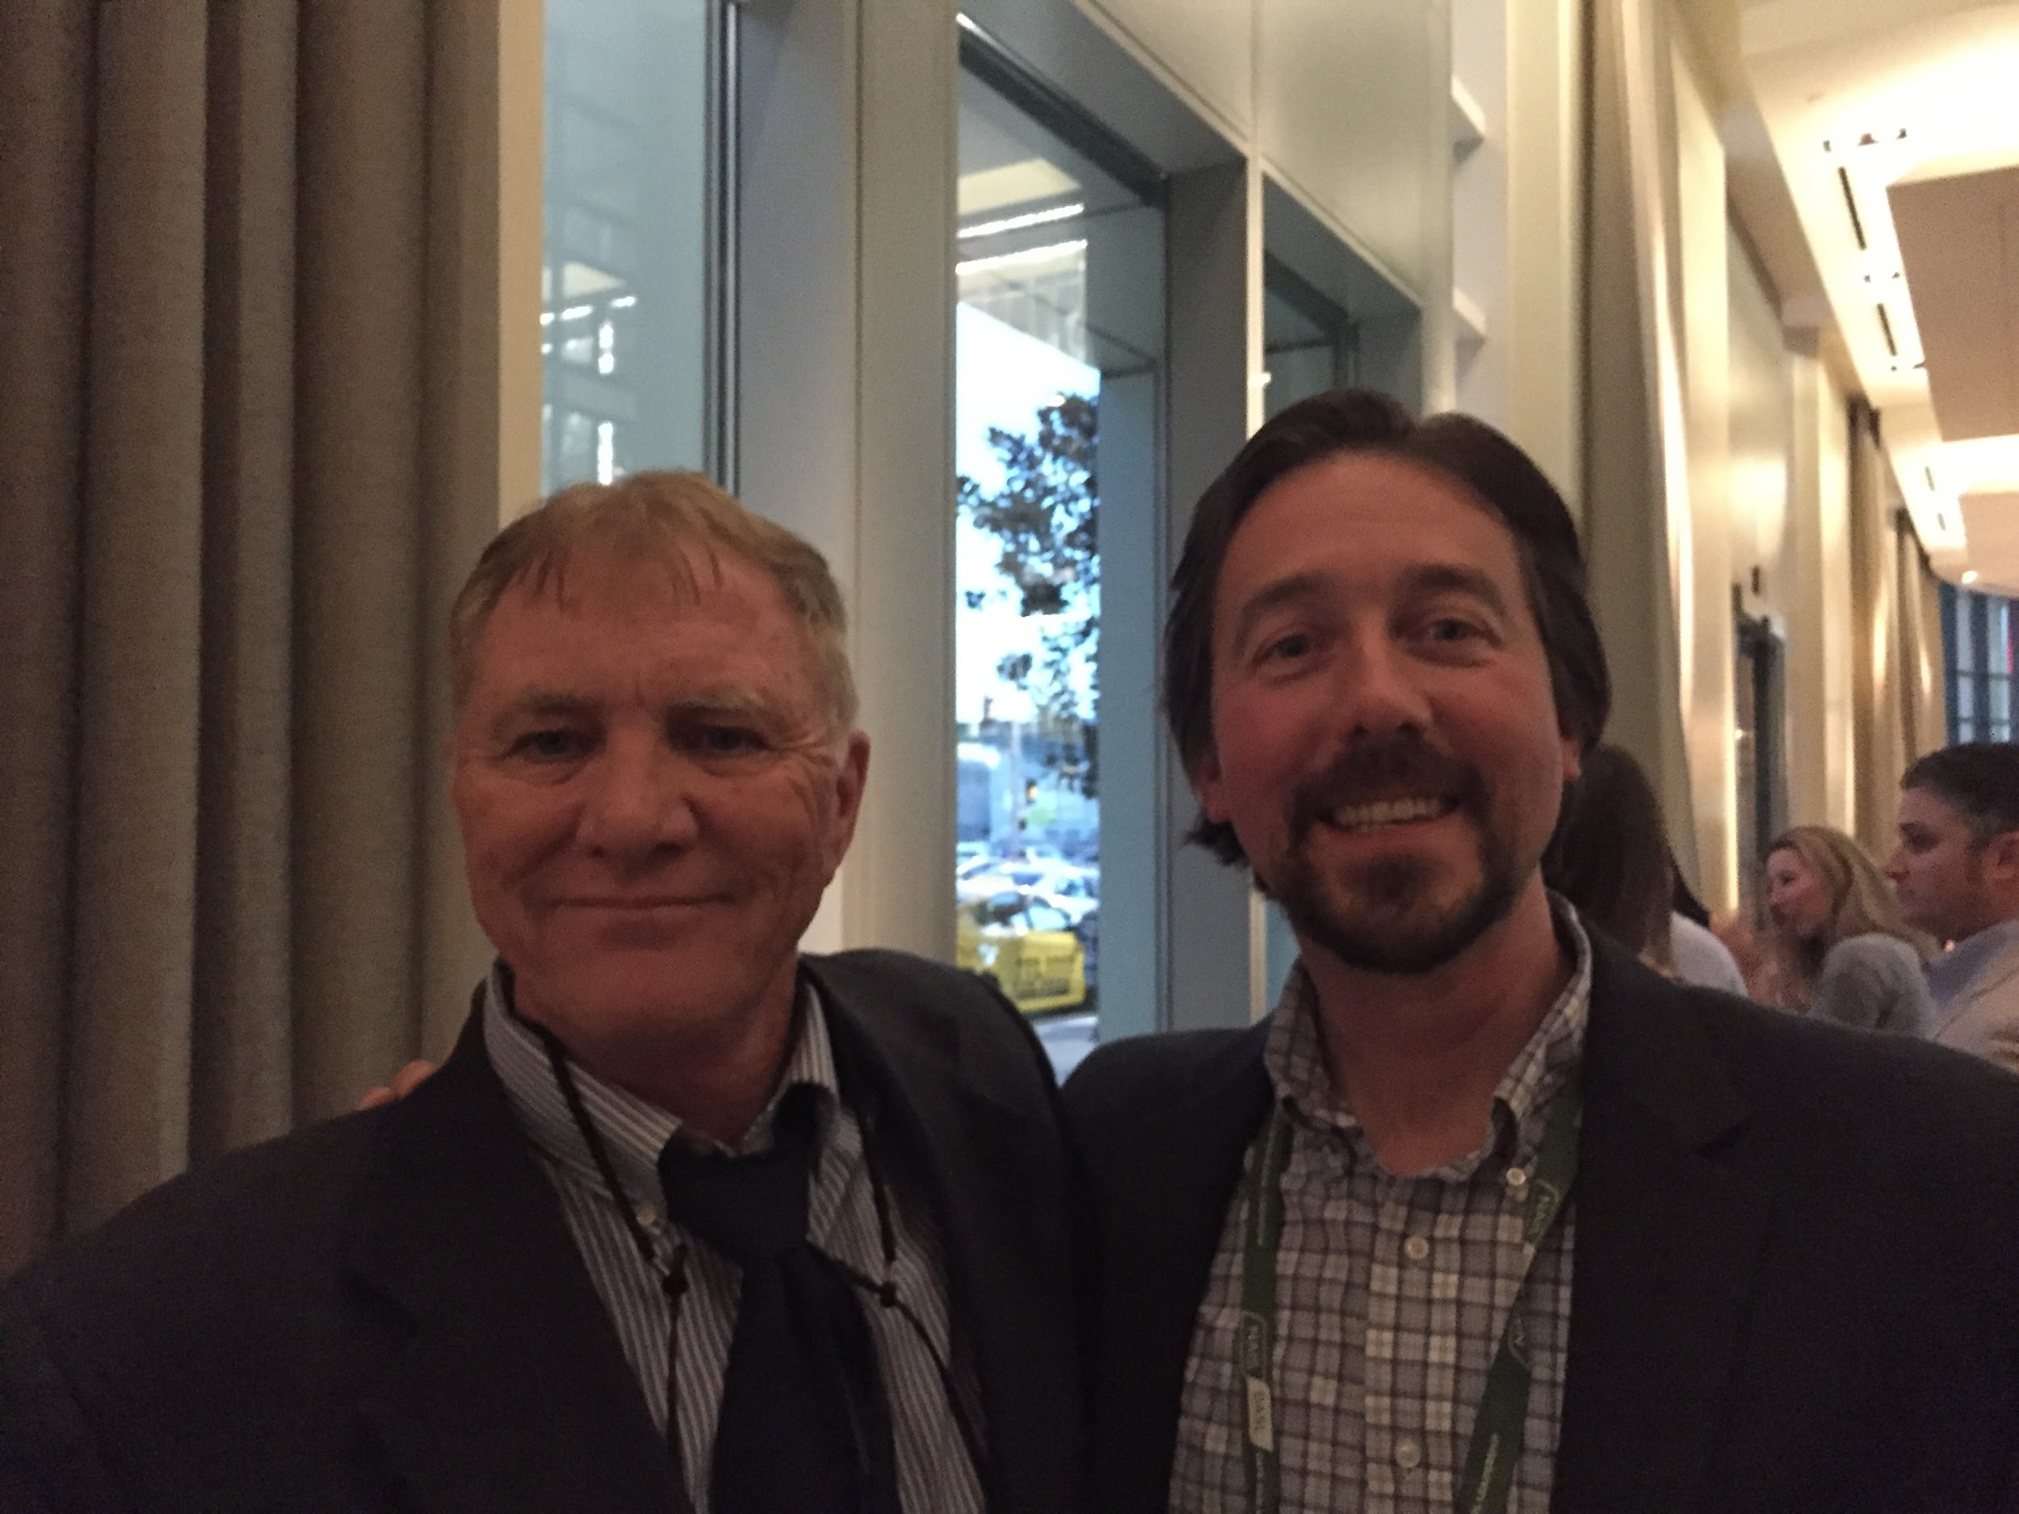

Slide 36
10. Stress | 9. EF | 8. Literacy | 7. Watchful Eye | 6. 20 minutes
5. Parent Allies | 4. Student Advocates | 3. Learning How | 2. Something Good | Mentor

Slide 37
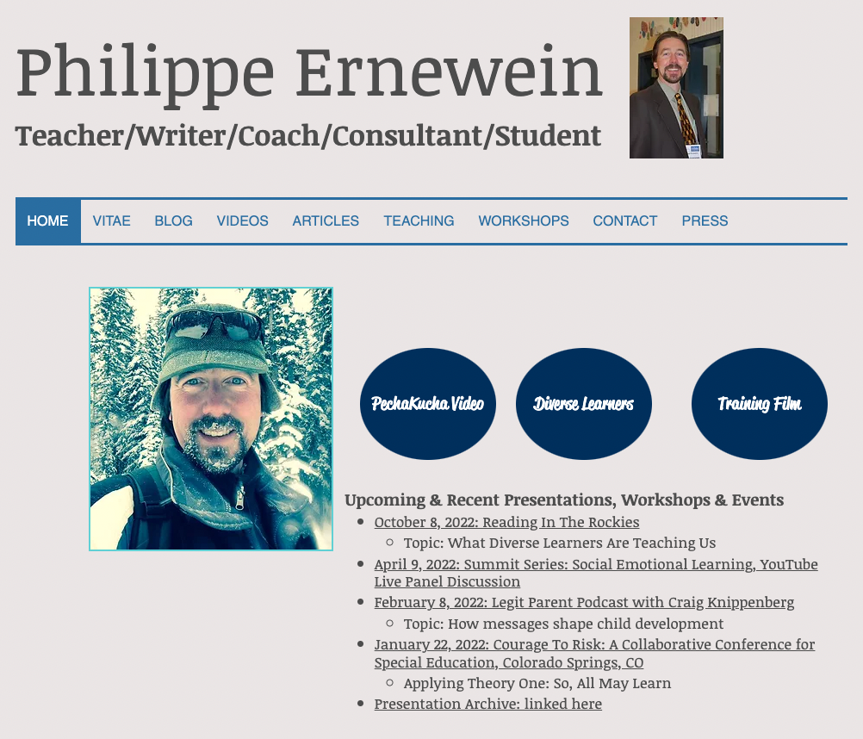
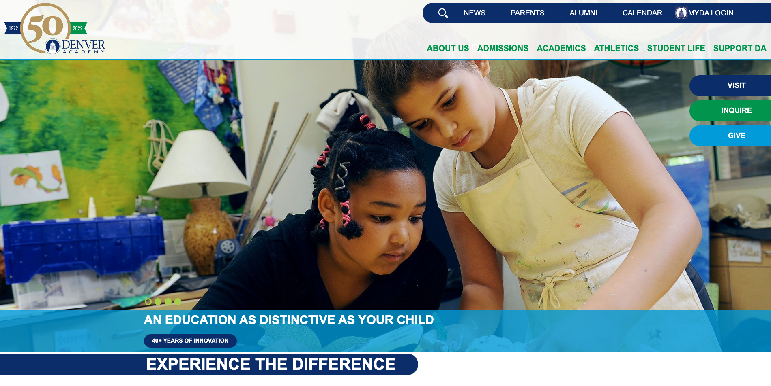
Thank you!
www.rememberit.org
www.denveracademy.org

